Slide 1
System programming report
楊富荃
資工二
111010542

Slide 2
introduction
This project is a simple console application designed to generate an application that can be used for customer billing services.
It uses C programming language as its base program.
It is based of C project from a website called <ITSourceCode>

Slide 3
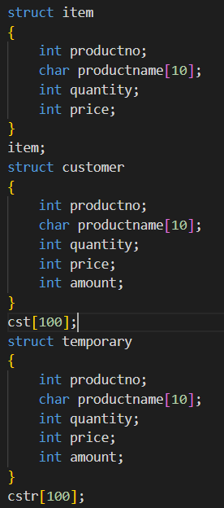
analysis
First line of code, I structured the item, customer, and temporary data. With each of the product name can contain up to 11 characters. Both of customer and temporary data I set it to have at max 100 data.

Slide 4
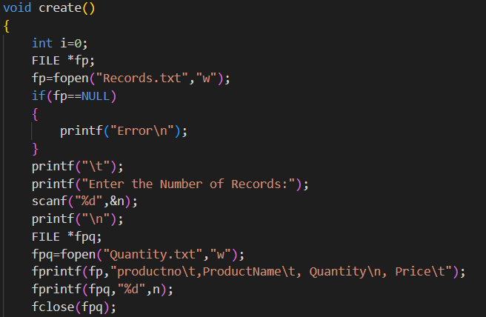
analysis
Then in this line of code, I created a file pointer to open “Records.txt” to create a record for the product related information such as product number, name, quantity, and it’s price.

Slide 5
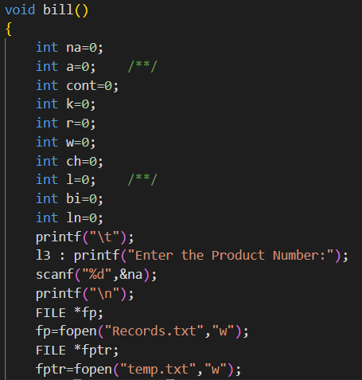
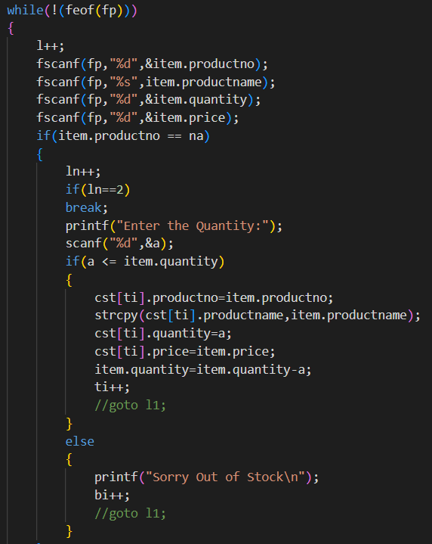
analysis
Continue to this line of code, I tried to create integers used for products information in scanf function to record the product related information and put it in a file record and then below that I create a statement to search for a product in a record. If it’s not there, it will immediately pop out an error output.

Slide 6
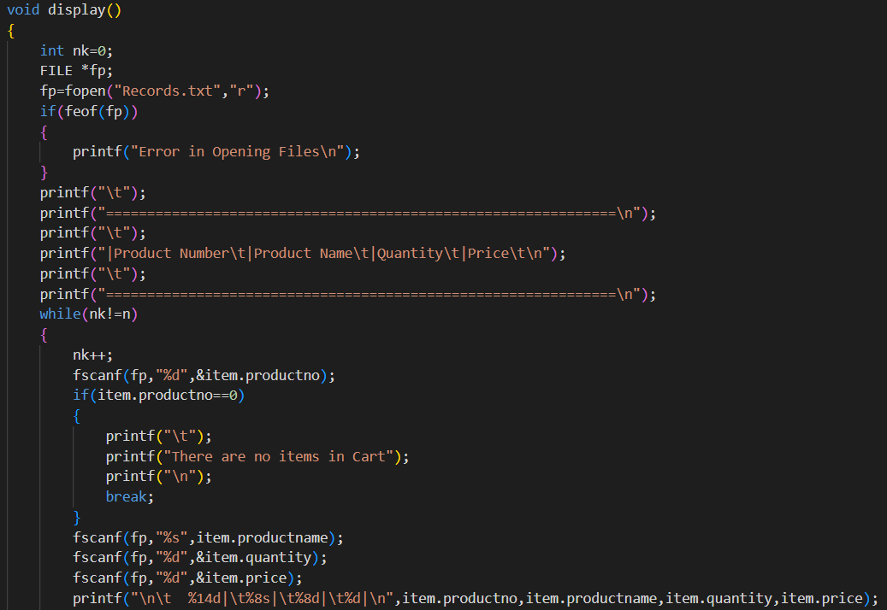
analysis
In this lines of command, I created a display function. The sole purpose is only to display which product available/recorded in the “Records.txt” file. If there’s no product, it will show an error output.

Slide 7
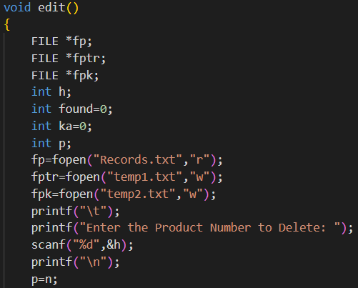
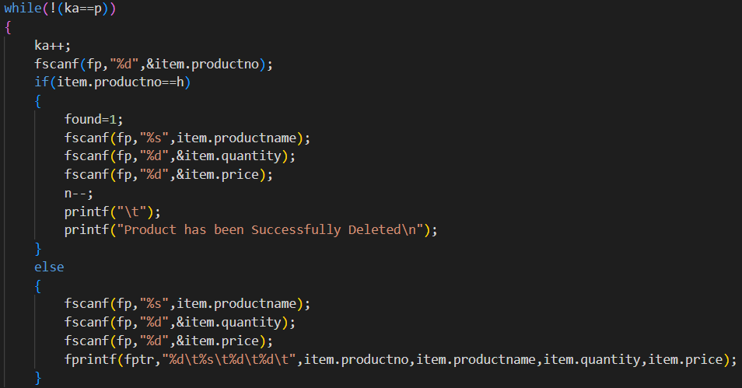
analysis
In this lines of command, I created an edit function, with it’s sole purpose to search for a product and then delete it afterward if needed. If not it will stay remained in the record file. Same in the display function, if the product number are incorrect, it will show an error output.

Slide 8
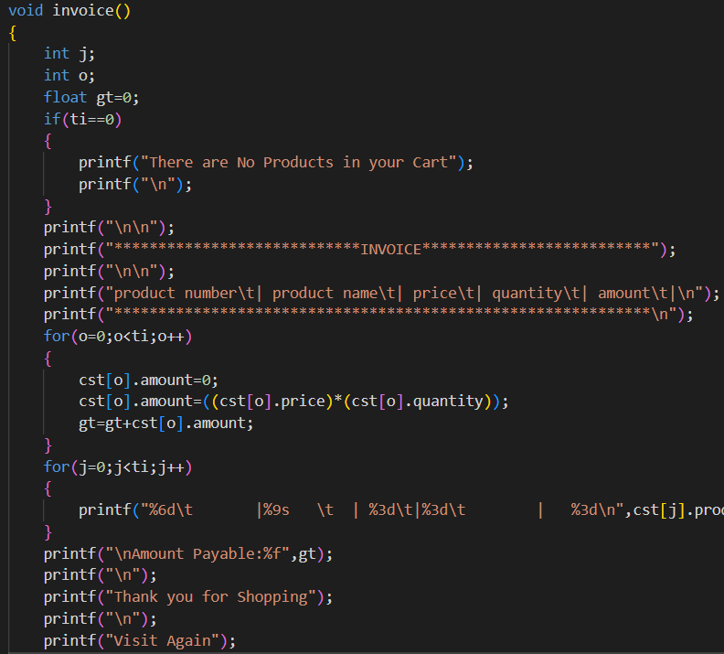
analysis
Proceed to the invoice bill function. The main objective of this lines of code is to display the product and the price of the product when customer is purchasing an item. It will basically calculate the amount of item and multiply it based on the price of the item

Slide 9
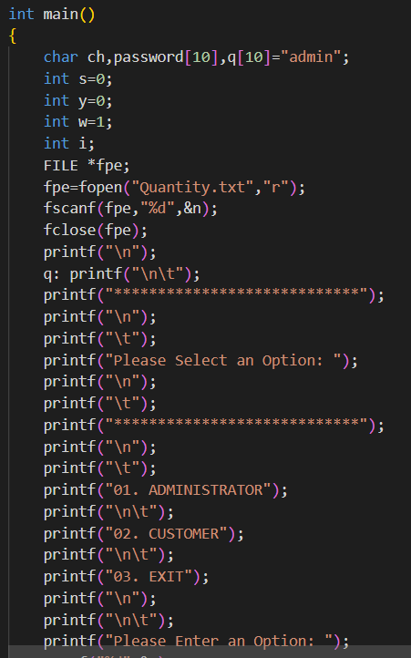
analysis
Then lastly, I created a main function which is basically for the main display. It uses file pointer “Quantity.txt” and below that I created a switch statement for it to cycle through the option 1-3 (administration, customer, and exit)
Note : administration password is “admin”

Slide 10
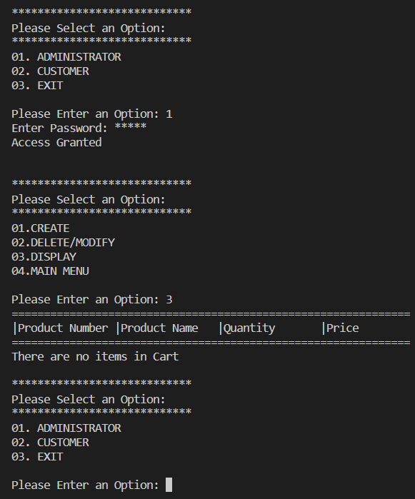
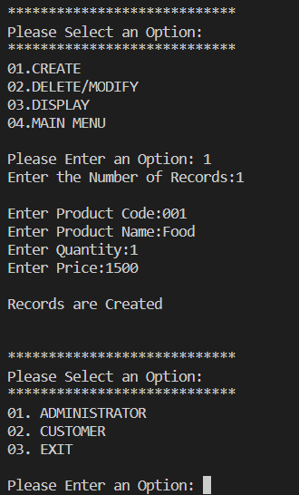
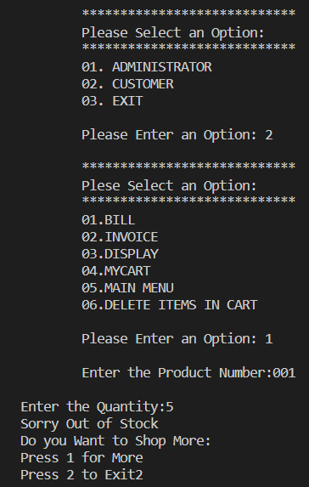
result
Here are some of the output from the program itself

Slide 11
Thank you

